Slide 1
Spring Boot
Dog Rescue:
Create schema and data files

Slide 2
In this video...
Create schema.sql
Create data.sql

Slide 3
schema.sql
Create in src/main/resources folder
Contains CREATE TABLE statements

Slide 4
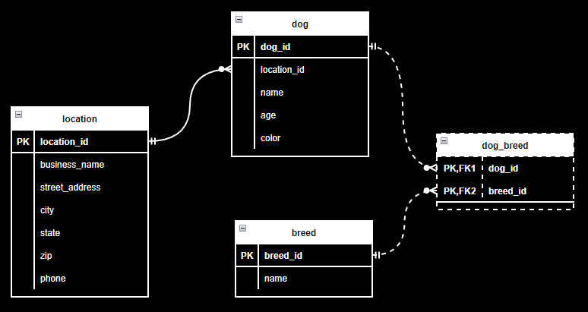

Slide 5
Recap: data.sql
Create in src/main/resources
Contains INSERT statements to add data to tables

Slide 6
Using .sql files
Spring JPA uses schema.sql to automatically create tables
Spring JPA uses data.sql to automatically populate tables
We won't let JPA (Hibernate) create the tables because we will use schema.sql and data.sql to manage data in tests

Slide 7
Let's do it!

